Slide 1
Power Consumption
Resistance and Load Prof. J. B. Jensen
Source: MAN Energy solutions – Marine Engines and Systems, Basic Principles of Propulsion

Slide 2
Learning outcome
By the end of this session, you should be able to:
Explain hull resistance
Know what affects resistances and power consumption
Explain the propulsion chain efficiency and how it can be improved
Discuss the power consumption of auxiliary equipment and hotel load.
The above criteria must be fulfilled along with criteria in Power consumption and Energy efficiency awareness lessons to:
Operate vessels commercially and energy efficiently, in accordance with environmental regulations.
Notes:
Spend some time to make it clear to the students how they will actually demonstrate their insight into this subject. Draw a line straight to how it will be used in the final assessment (case report).

Slide 3
Content
Hull resistance
Propulsion chain efficiency
Auxiliary and hotel load
Notes:
These contents are the minimum taken from the toolbox guide. It is entirely possible to expand with more power production methods. Good candidates could be dual fuel engines and/or fuel cells.

Slide 4
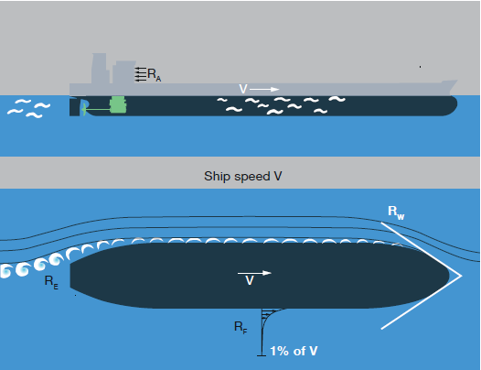
Total Resistance R_{T}
Frictional Resistance (R_{F})
Residual Resistance (R_{R})
Eddy Resistance (R_{E})
Wave Resistance (R_{W})
Air Resistance (R_{A})
Source: MAN Energy solutions – Marine Engines and Systems, Basic Principles of Propulsion
Notes:
Explain briefly the different types of resistance. In the next slides each will be covered in more depth

Slide 5
Frictional Resistance (R_{F})
Depends on the wetted surface
Depends on surface conditions (paint, marine growth etc.)
For slow moving vessels (Tankers, Bulk Carriers, etc.) frictional resistance can be 70%-90% of the total.
For faster moving vessels it can be as little as 50% of the total
Notes:
Explain Frictional Resistance

Slide 6
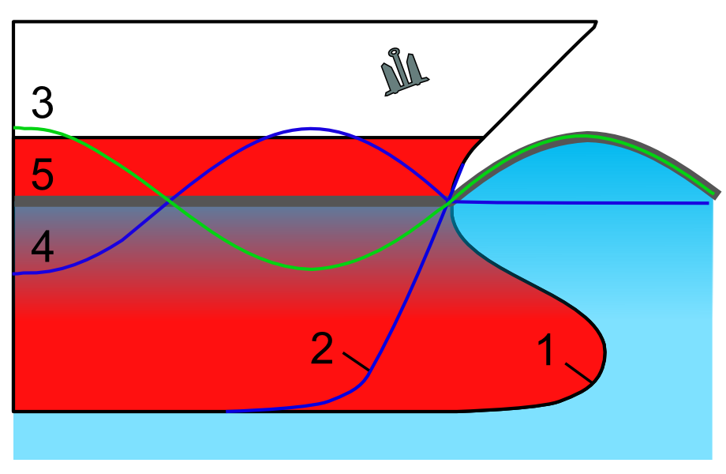
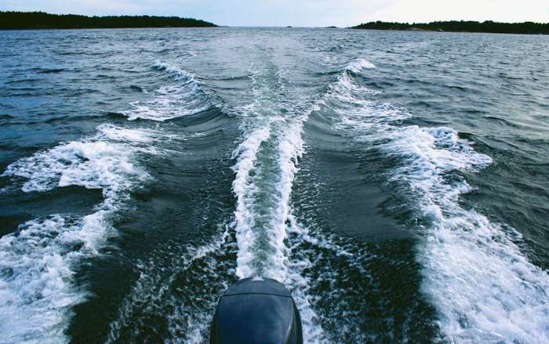
Residual Resistance (R_{R})
Residual resistance is resistance caused by the creation of eddies and waves. Eddies can be reduced by the hull shape, especially at the stern. Waves can be reduced by bulbous bow.
Source: https://en.wikipedia.org/wiki/Bulbous_bow
Source: https://www.britannica.com/science/turbulent-flow
Notes:
Explain residual resistance

Slide 7
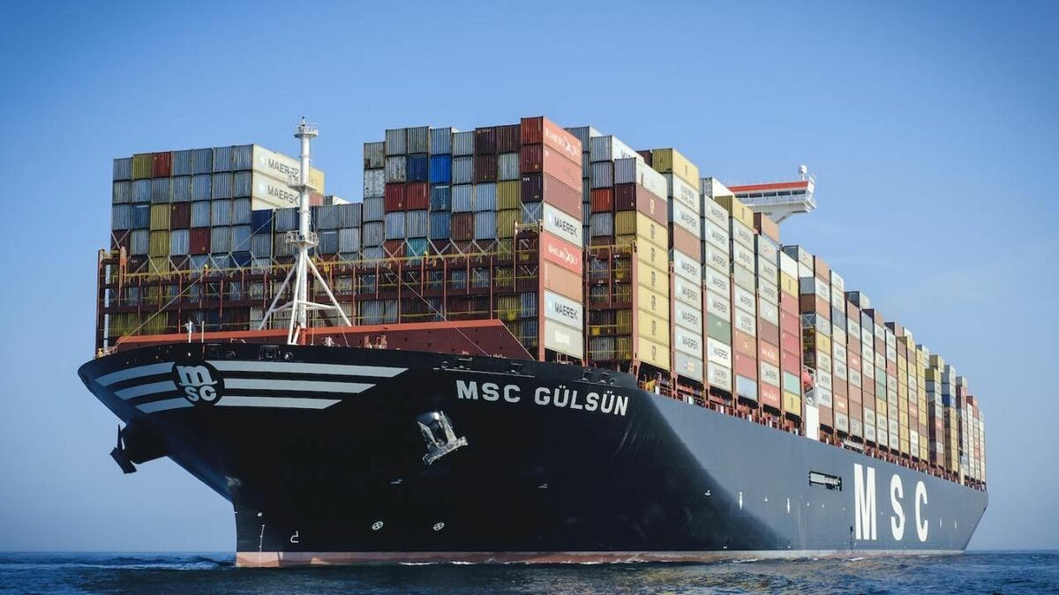
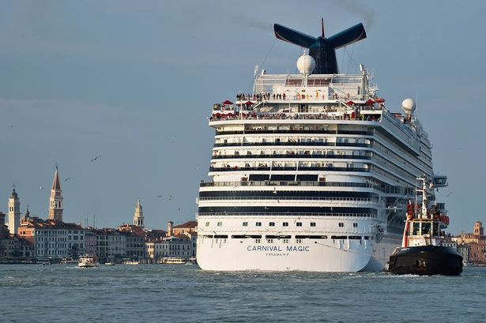
Air Resistance (R_{A})
Air resistance is usually only around 2% but can be as high as 10% for ships with a large wind area.
Source: https://www.mirror.co.uk/lifestyle/travel/venice-cruise-st-marks-square-2705417
Source: https://www.rivieramm.com/news-content-hub/news-content-hub/msc-guumllsuumln-a-lsquotextbookrsquo-example-of-cargo-handling-system-collaboration-56349
Notes:
Explain air resistance

Slide 8
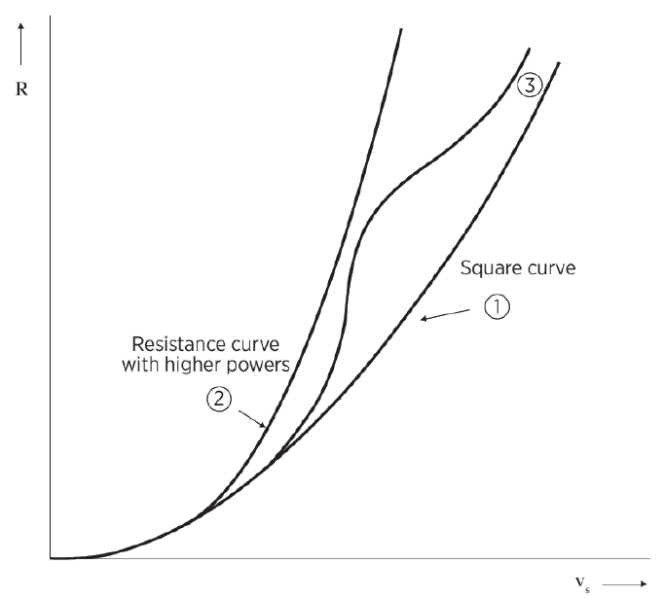
Hull Resistance
The ship’s resistance is roughly square to the ships speed (1)
For higher speeds the curve may be steeper (2)
For planing craft, twin hull or other misc. hull shapes the curve be more complex (3)

Slide 9
Propulsion chain efficiency
Source: Design of propulsion and electric power generation systems fig 3.8 ch. 3
Notes:
Explain the efficiencies. The depth of which each step is explained is variable. It is important to focus on the principles and not the equations/maths. Use blackboard to draw a simple propulsion chain and highlight the main losses.

Slide 10
Summary for propulsion
Lower these
Improve these

Slide 11
Auxiliary and Hotel loads
Source: Kongsberg MC90 simulator

Slide 12
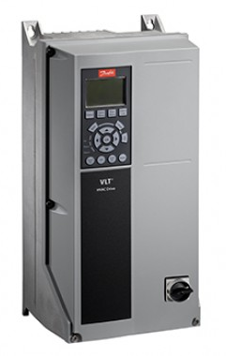
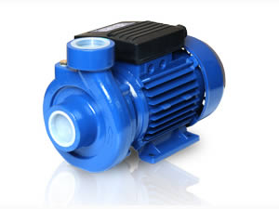
Reduce load
Effective pumps/electric motors
Frequency converters
Crew behavior and attitude
http://waterpumpstech.com/1-2-4-centrifugal-pump/189617/
Source: http://www.iesco.ge/eng/products/?category_id=61

Slide 13
Hull Resistance Exercise

Slide 14
Propulsion Chain Exercise

Slide 15
Thank you

