Slide 1
Power Production
Conversion of Energy Prof. J. B. Jensen
Source: MAN Energy solutions – Marine Engines and Systems, Basic Principles of Propulsion

Slide 2
Learning outcome
By the end of this session, you should be able to:
Demonstrate basic knowledge of the diesel engine
Demonstrate knowledge of how to produce power effectively.
Understand the production side of power management systems
Discuss common challenges leading to inefficient power production
The above criteria must be fulfilled along with criteria in Power consumption and Energy efficiency awareness lessons to:
Operate vessels commercially and energy efficiently, in accordance with environmental regulations.
Notes:
Spend some time to make it clear to the students how they will actually demonstrate their insight into this subject. Draw a line straight to how it will be used in the final assessment (case report).

Slide 3
Content
Diesel engines
Diesel engine efficiency
Specific fuel oil consumption
Electric generators
ESS batteries
Notes:
These contents are the minimum take from the toolbox guide. It is entirely possible to expand with more power production methods. Good candidates could be dual fuel engines and/or fuel cells.

Slide 4
Diesel Engines
Why are diesel engines so common in ships?
Prime mover
Auxiliary engines
Where does the “rest” of the energy go?
Source: MAN (https://www.mandieselturbo.com/docs/default-source/shopwaredocumentsarchive/two-stroke-low-speed-diesel-engines.p)
Notes:
Diesel engines are the most effective power converter we have available. Briefly explain the principles of the diesel engines, use a blackboard as necessary. The underlying principle of the diesel engine is the foundation of the dual fuel engines and also many other internal combustion engines using newer fuels.

Slide 5
When is a diesel engine most effective?
Specific fuel consumption
This is the mass of fuel consumed per energy unit. It is normally indicated in
grams per kilowatt hour. [g/kWh]
The unit is tricky but: g = 0.001 kg and kWh = 3,600,000 J
Notes:
The lower the fuel consumption, the less fuel the engine uses and the higher the engine's 'return
efficiency' is. In this way, one can easily make comparisons of engines.
Lubricating oil and fuel consumption constitute by far the highest costs in ship exploitation.
Of course the measurement of fuel consumption must take place under the same conditions; these
have been laid down in the
But is it possible to use the power?

Slide 6
SFC
η_{e} = effective efficiency
Notes:
Spend some time talking about the units. Joule, Watt, kilowatt hour etc. These are often confused. It is very important to spend some time understanding SFC since it is important later for the calculations necessary.

Slide 7
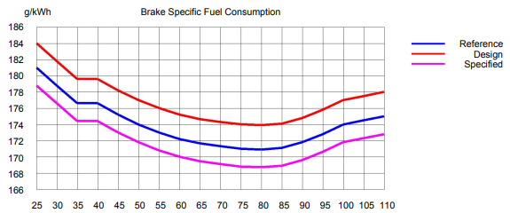
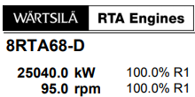
SFC curves
Notes:
Explain the nature of SFC curves for diesel engines and spend some time discussing the optimum point and how this can be moved.

Slide 8
Electric Generators
pr. energy unit

Slide 9
Load on generators
Source: Kongsberg MC90 simulator
Notes:
The generators need to produce the power needed in any given moment. There must be balance and room for “spikes” in the capacity. How does this fit with how the optimum operation point for diesel engines.

Slide 10
ESS – Electrical Storage Systems
Source: https://mfame.guru/improving-engine-robustness-diesel-electric-vessels/
Notes:
Explain how an ESS can help mitigate some of the weaknesses of diesel engines in a diesel electric setup. Explain hybrid and fully electrical vessels. Make it clear that there are a lot of different set-ups and they must be customised to the specific operation pattern of the vessel in question.

Slide 11
Exercise
Make a presentation of the slow steaming concept, introduced in 2007.
Let the presentation have emphasis on how it makes sense to let the ships steam well outside the optimum point and with a significantly worse SFC than possible.

Slide 12
Thank you

